Slide 1

Personal Blog System
Group Member
ZHAO Haiqi
18087348G
CHEN Yongxin
18073824G
COMP 5321 Enterprise Web and Internet Computing For Managers
Final Project

Slide 2
Table of Content
Introduction
Angular + Firebase
Database
Structure
Function
Demonstration
Q & A

Slide 3
Introduction
Description
01
Personal blog system
Main Purpose
02
Custom design & settings
Features
03
No advertisement & social media
Neat and clear posts reading & sharing
Support markdown format

Slide 4

Angular (Front-end)
Components Based
01
MVC Web design. Good communication with back-end
Dynamic Web Page
02
Displays different content in a single view
TypeScript
03
Strong Programming Language. Powerful functionalities. Strict syntax.

Slide 5
Firebase (Back-end)
Cloud NoSQL Database (Firestore)
01
Connect it everytime, everywhere. No need DB server, DB software.
Authentication
02
Powerful Api for Sign in and SIgn out. Account are stored at Cloud DB.
Hosting
03
Deploy program to Firebase.
Storage and Analysis
04
Cloud FIle Storage and Web Throughput analysis

Slide 6
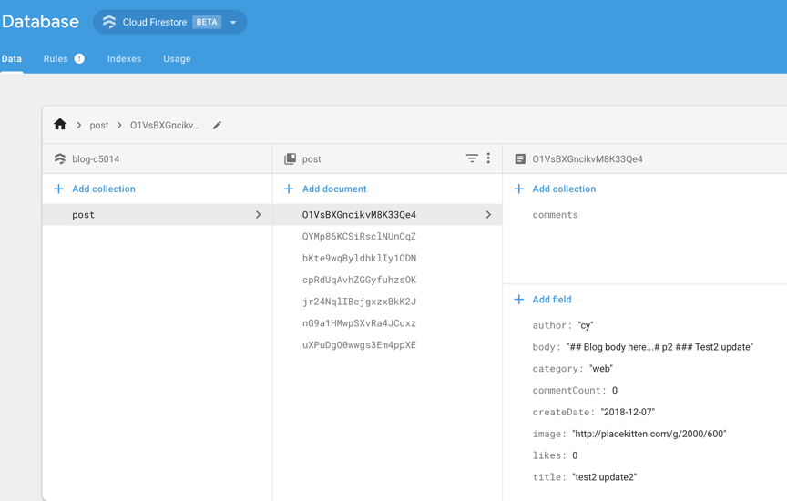

FireStore Cloud Database

Slide 7
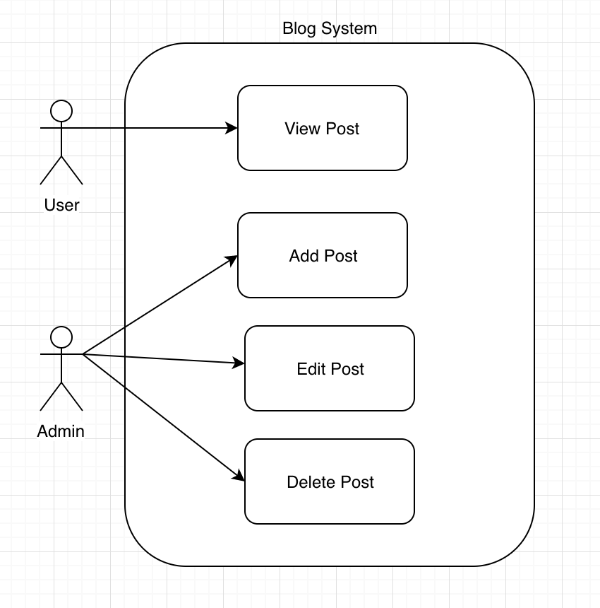
Structure
User case diagram

Slide 8
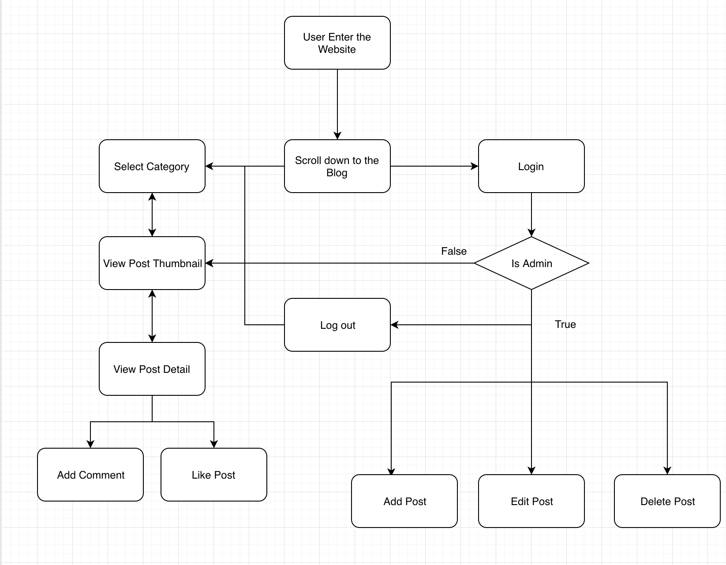
Structure
Flowchart

Slide 9
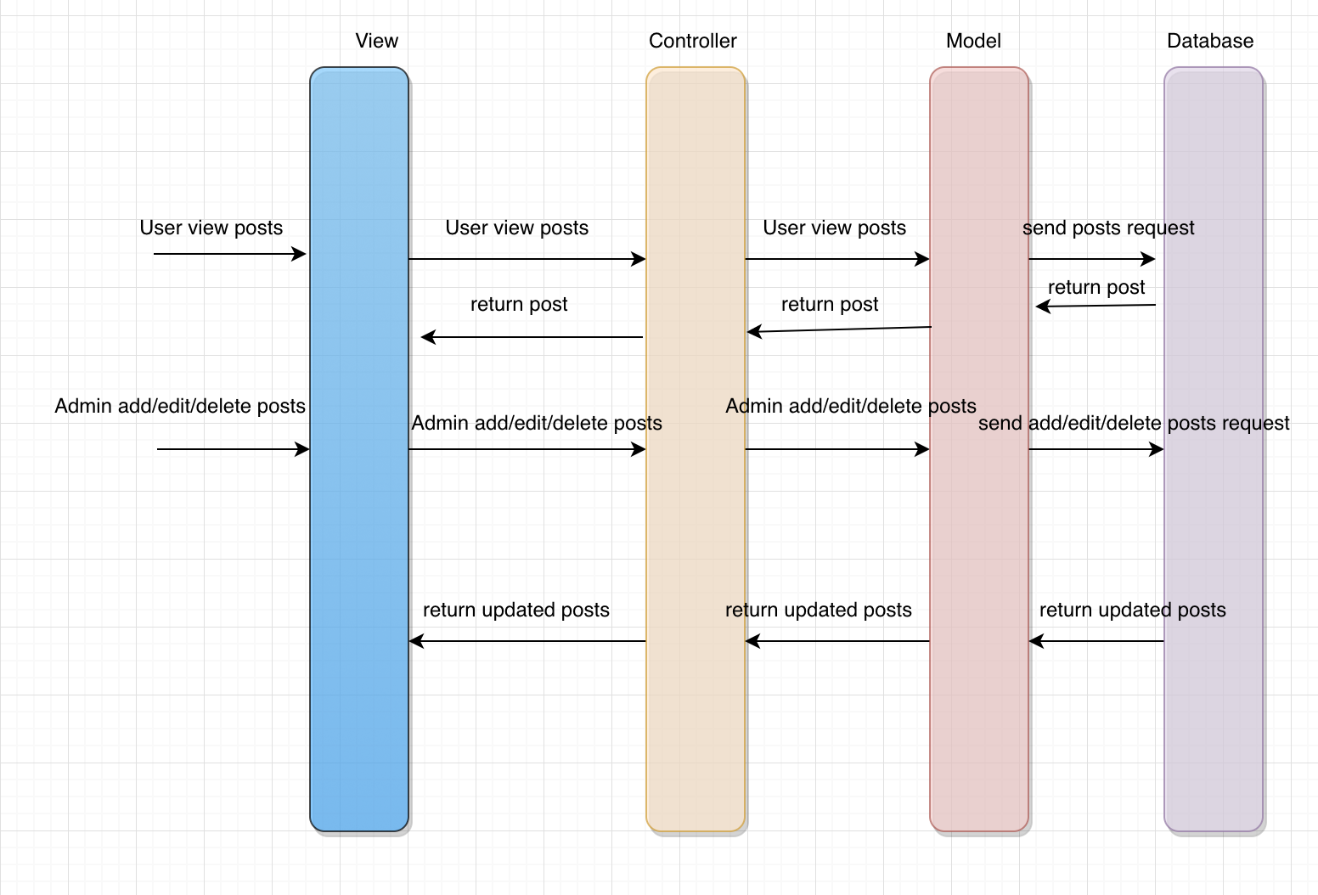
Structure
Data stream interaction

Slide 10
Function
Authentication
Display Post
01
04
Login & Logout
Display thumbnail & detail
Post Categories
Add Comment
02
05
List posts by categories
Add comments
Posts Management
Add Likes
03
06
Add/Edit/Delete
Like posts

Slide 11
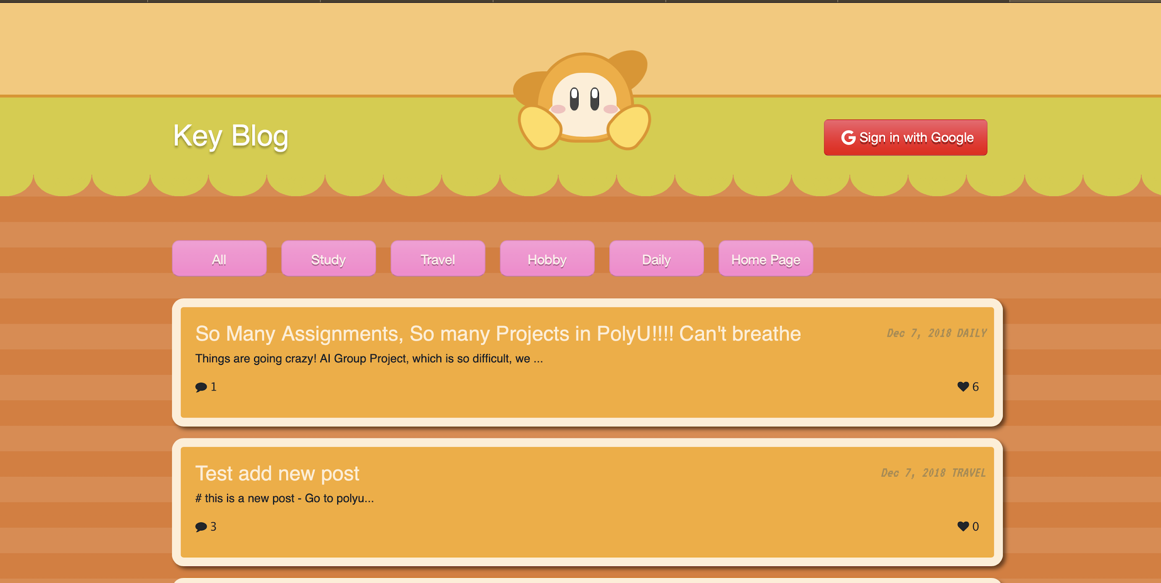
Demonstration
Get Start

Slide 12
Q & A
For more info
https://github.com/tavik000/AngularFireBlog#contents

Slide 13
E N D
T H A N K S

